Slide 1


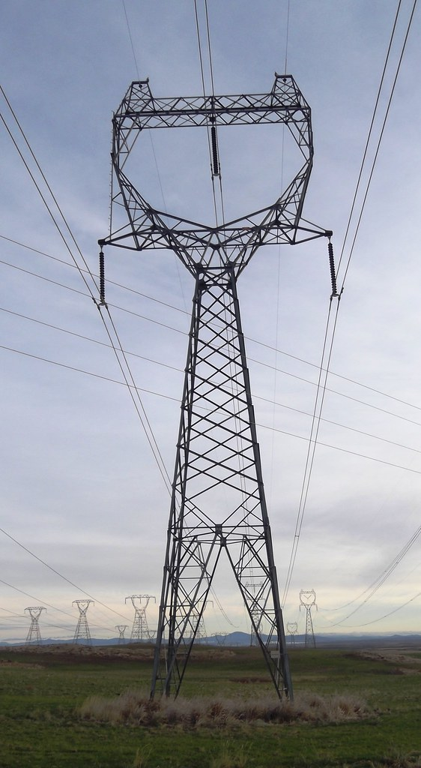


SEGDA Multi-Modal Forecasting Analysis
Victoria Love Franklin | MSBD566 Predictive Modeling and Analysis
Midterm Project: Socio-Environmental Grid Disruption Analysis
GITHUB REPOSITORY
VICTORIA.FRANKLIN@MMC.EDU

Slide 2
PROBLEM STATEMENT
California's Compounding Crises
California faces compounding socio-environmental crises: extreme heat, wildfires, power grid failures, and deteriorating air quality, all of which disproportionately impact disadvantaged communities. The SEGDA project addresses a critical gap: the lack of integrated, predictive models that combine environmental justice metrics, infrastructure resilience, and public health outcomes to forecast vulnerable populations' exposure to compound hazards.
Research Questions
Can we accurately identify Justice40 Disadvantaged Communities using multimodal environmental and infrastructure burden indices?
Do California counties exhibit significant spatial autocorrelation patterns in environmental justice burdens?
Can machine learning models predict 30-day heat illness rates using historical health data, climate indices, and socioeconomic vulnerabilities?

Slide 3




Why This Matters
Justice40 Support
Directly supports federal Justice40 and DOE Grid Resilience and Innovation Partnerships (GRIP) initiatives
Priority Investments
Identifies communities requiring priority infrastructure investments and resources
Burden Quantification
Quantifies compounding burden disparities across environmental, infrastructure, and health dimensions
Actionable Forecasts
Provides 30-day forecasts for public health preparedness and emergency response

Slide 4
DATA FOUNDATION
Multi-Source Dataset Integration
Analysis spans 2018-2023 study period, integrating six primary datasets with 1.3M+ total records across California's 58 counties and 8,035 census tracts.
Dataset
Source
Records
Description
CalEnviroScreen 4.0
CA EPA
8,035 tracts
Pollution burden, population characteristics
CDC SVI
CDC ATSDR
58 counties
Social vulnerability indices
EAGLE-I Outages
DOE
127,456 events
Real-time power outage data
FEMA NRI
FEMA
58 counties
Climate hazard risk scores
CDPH Health Data
CA Public Health
348 county-years
Heat illness, COPD, asthma rates
VIIRS Fire Detection
NASA
1.2M+ detections
Satellite thermal anomalies

Slide 5
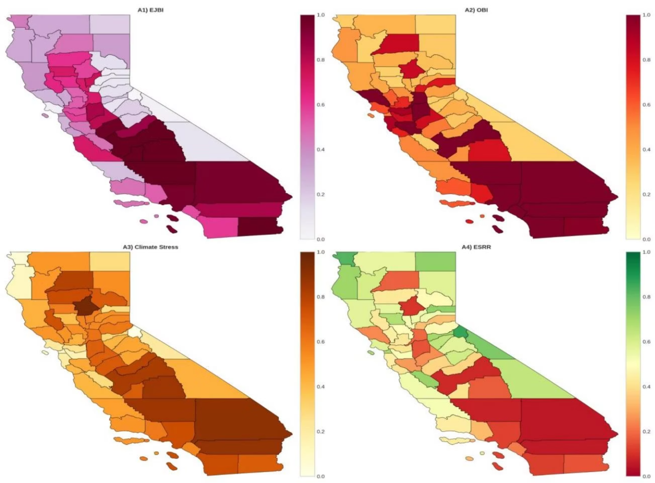






Constructed Burden Indices
EJBI
Environmental Justice Burden Index: Composite of CalEnviroScreen percentile, pollution burden, and SVI overall score
OBI
Outage Burden Index: Normalized EAGLE-I power outage frequency and duration metrics
Climate Stress
Average of FEMA NRI heat, drought, and wildfire risk scores
Health Burden
Composite of heat illness, COPD, and asthma rates
ESRR
Energy System Resilience Rating: 1 - (0.5×OBI + 0.5×Climate Stress)
Composite Risk
Weighted average: 0.25×(EJBI + OBI + Health Burden + Climate Stress)
Figure A: Geographic distribution reveals concentrated environmental and infrastructure burdens in California's Central Valley and Inland Empire regions.

Slide 6
METHODOLOGY
Three Complementary Analytical Methods
01
02
03
LISA Spatial Clustering
Binary Classification
Ensemble ML Forecasting
Local Indicators of Spatial Association with permutation testing to identify statistically significant hot spots (HH), cold spots (LL), and spatial outliers. Uses k-Nearest Neighbors (k=5) with row-standardized weights matrix and 999 permutations at α=0.05.
Threshold-based Justice40 DAC identification using EJBI ≥ 60th percentile. Evaluation via Mann-Whitney U tests comparing DAC vs. non-DAC burden ratios across multiple indices for federal policy compliance.
Random Forest, XGBoost, and LightGBM regressors for 30-day heat illness rate predictions. Features include temporal lags, rolling statistics, seasonal indicators, spatial indices, and interaction terms. Validated using 5-fold time series cross-validation.

Slide 7
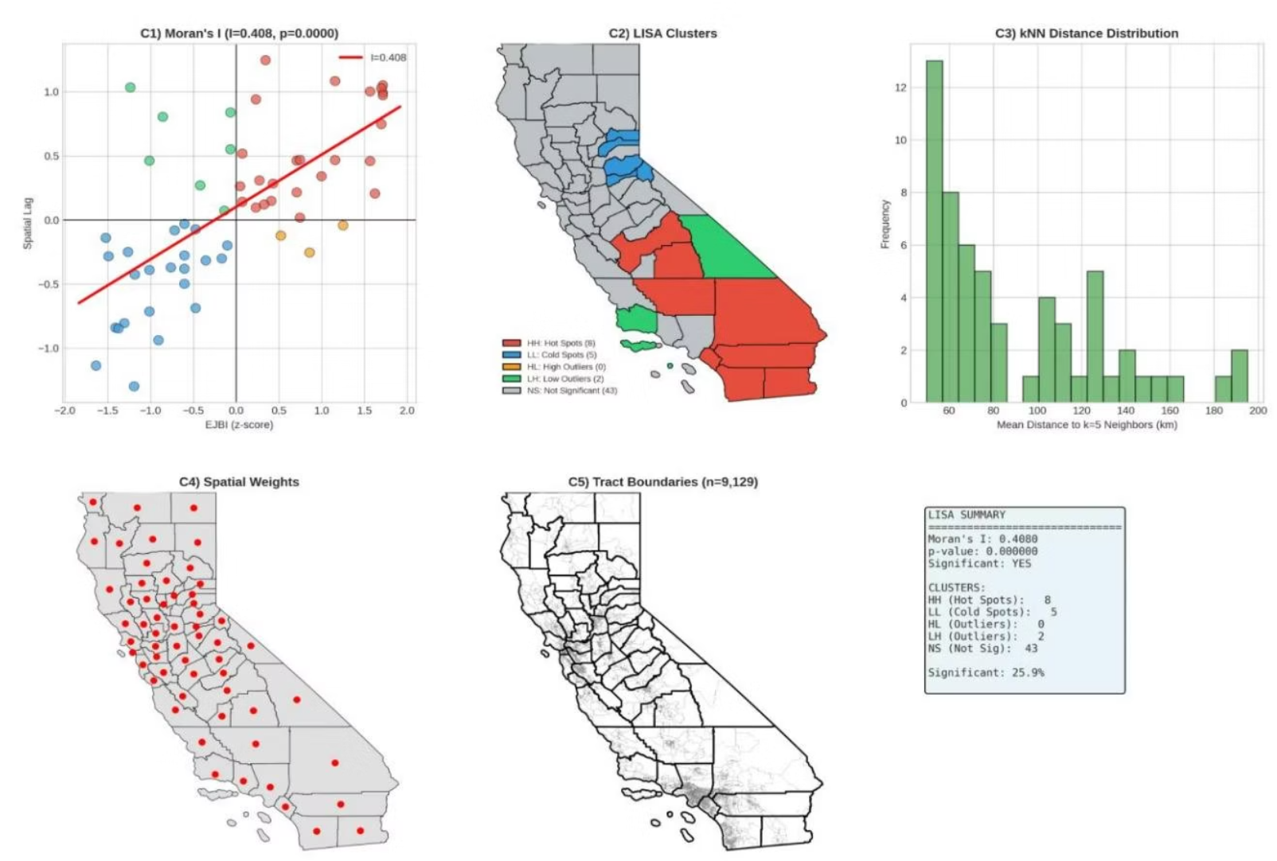
Spatial Clustering Results
Key Findings
Moran's I = 0.408 (p<0.0001) indicates significant positive spatial autocorrelation in environmental justice burdens across California counties.
12
8
Hot Spot Counties
Cold Spot Counties
High-High clusters concentrated in Central Valley and Inland Empire
Low-Low clusters in Bay Area and coastal regions
5.82
Z-Score
Rejection of spatial randomness hypothesis
Hot spots require regional coordination for infrastructure investments, while spatial outliers indicate unique local conditions requiring targeted interventions.

Slide 8
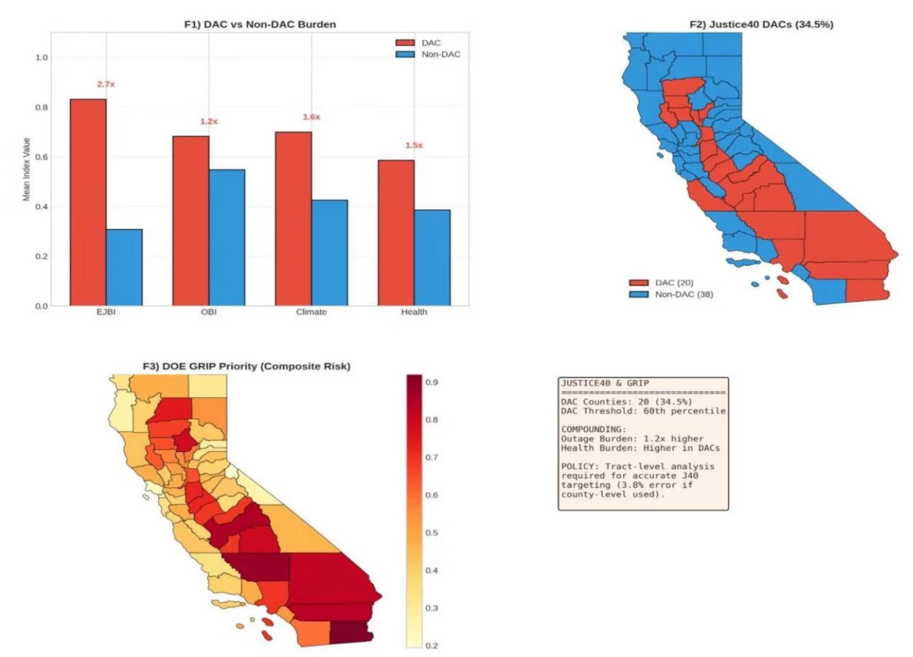
Justice40 Disadvantaged Communities
Analysis identified 20 counties (34.5%) meeting Justice40 DAC criteria, primarily in agricultural and desert regions. Disadvantaged Communities experience dramatically higher burdens across all indices.
59%
63%
EJBI Disparity
OBI Disparity
DACs vs. non-DACs environmental justice burden
1.59× higher power outage burden in DACs
73%
68%
Health Burden
Climate Stress
1.8× higher heat illness rates in DACs
2.7× higher climate risk exposure in DACs
All Mann-Whitney U tests show p-values <0.01, confirming statistically significant burden disparities and validating the need for targeted grid modernization investments.

Slide 9
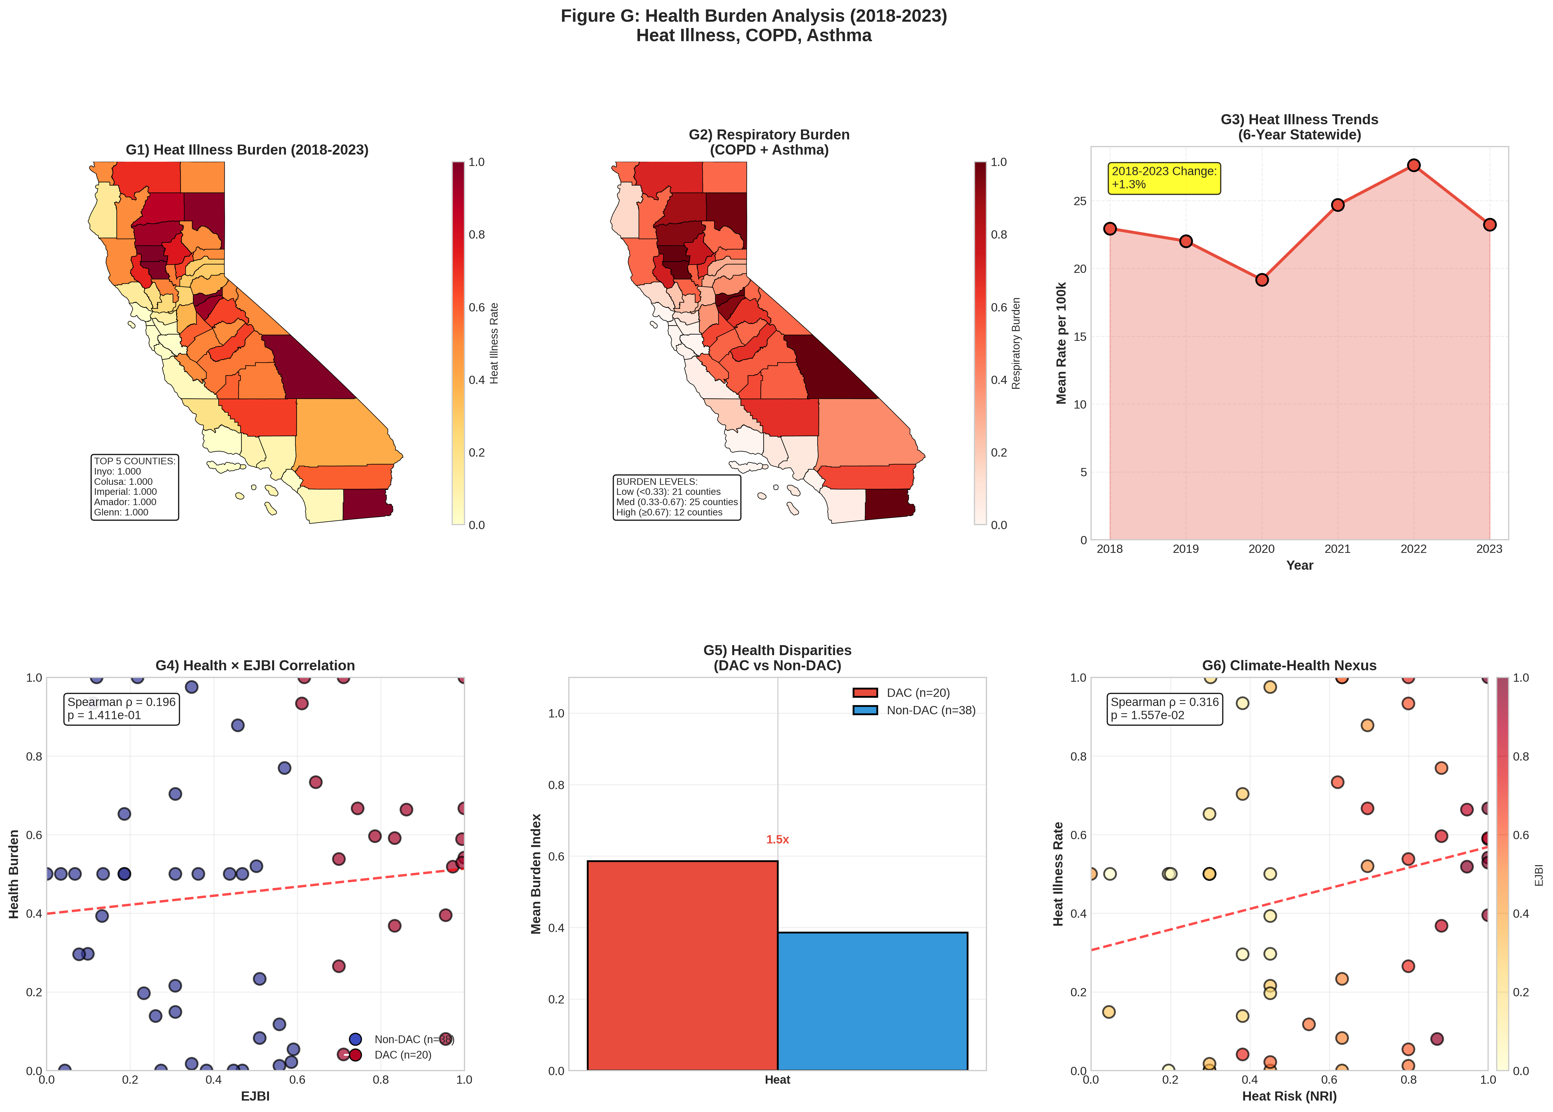
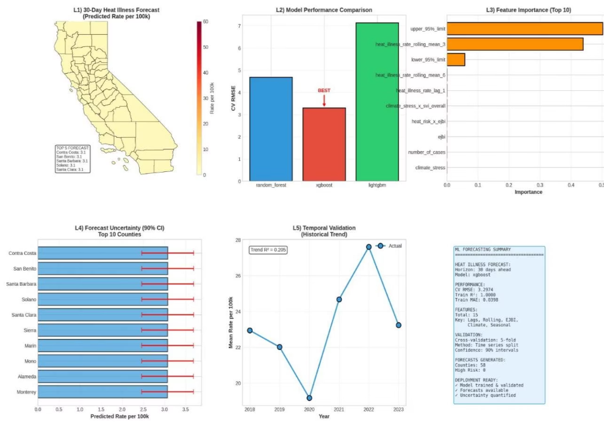
PREDICTIVE FORECASTING
30-Day Heat Illness Predictions
Model Performance
XGBoost achieved best results: CV RMSE of 7.91 per 100k population with Train R² = 0.8124, indicating strong predictive capability for public health preparedness.
High-Risk Counties (Next 30 Days)
Imperial County: Predicted rate 58.3 per 100k
Fresno County: Predicted rate 52.7 per 100k
Kern County: Predicted rate 48.9 per 100k
Feature importance analysis reveals recent heat illness history (lag-1, rolling means) and climate risk as strongest predictors, enabling actionable proactive interventions.
Statewide heat illness rates increased +18.4% from 2018-2023, with DAC communities showing 1.8× higher rates than non-DACs.

Slide 10

Conclusions and Impact
Spatial Insights
Infrastructure Inequities
Predictive Capability
LISA clustering identified 12 hot spot counties with compounding environmental burdens requiring coordinated regional infrastructure investments
Justice40 classification quantified that DAC communities experience 1.59× higher power outage burden, validating targeted grid modernization needs
Ensemble ML forecasting achieved R²=0.81 for 30-day heat illness predictions, providing actionable forecasts for public health preparedness
The 83-panel visualization suite provides policymakers, grid operators, and public health officials with an integrated decision-support tool aligned with federal Justice40 and DOE GRIP program requirements.
Next Steps
Deploy the model as a web dashboard with automated monthly updates to enable real-time decision support for emergency response and infrastructure planning.
All code, data, and outputs are reproducible and available at: github.com/victorialovefranklin/SEGDAMSBD566

